Slide 1
LET’S BUILD
YOUR FUTURE
[Insert your company’s logo here]
1
Notes:
Insert your company name or logo.
Introduce yourself: Your name, position and company. Say you’re there to talk about a great career path that they don’t hear enough about – careers in construction.
Be sure to include your company’s logo on this slide and put the number and email of your company or yourself at the footer of all slides. (This way, if someone has to step out, they don’t have to wait until the very end to get your contact information.)

Slide 2
What is Construction?
Notes:
Start off by posing a question: What is construction? See what answers your audience gives. See what words come to mind when they hear the word construction.
Transition by commending their answers and explaining how construction is an exciting and interesting industry that has a massive role in our society.

Slide 4
Construction
Is
Everywhere
Notes:
Re-emphasize points made in the previous video. Everything starts with construction! Malls, hospitals, homes, stadiums, schools, offices, roads, factories. Without the construction industry, we wouldn’t have any buildings, any electricity, any running water or AC. Although we may not think about construction every day, it is an important part of our lives.
You can replace these photos with projects your own company has worked on. Give a few brief examples of the different projects your company is a part of.

Slide 5
Notes:
Continue your discussion of cool projects your company works on and provide more pictures. You can also talk about the different locations, size of project and any other interesting facts.
Insert your own project photos.

Slide 6
State Of The Industry
The Construction Field Is Thriving.
Consider being a part of a lucrative field.
AGC
According to the Associated General Contractors of America
$1.3
Trillion dollars in structures are built per year
700,000
Construction companies employing
7
Million total employees
Notes:
The construction industry is growing! Briefly highlight your favorite things about your job. This would give your audience some understanding about why people join and what they may also like about working in the field.

Slide 7
WHAT GOES INTO A CONSTRUCTION PROJECT?
Carpentry
Masonry
Welding
Electrical
HVAC Technician
Civil Engineering
Plumbing
Heavy Machine Operation
…And more!
TRADES
Notes:
Now that you’ve given an overview on the different types of construction projects, it’s time to look deeper into what actually goes into those projects: the craft skills!
Construction involves a lot of people with high skills working together.
Every building has a number of different components, and they all need compliment each other. For example, an air conditioning unit can’t function without the electrical and plumbing systems.
This is a great time to give insight and examples from your own company or your own experience. Which crafts does your company specialize in? What crafts did you do? How did individual crafts come together to successfully complete a project?

Slide 8
Construction Innovations and Inventions
PPE
CAD
Personal Protective Equipment
Computer-Aided Design
BIM
VR
Building Information Modeling
Virtual Reality
Notes:
Construction is constantly developing and enhancing. It has evolved into a high-tech business.
Here is an opportunity to discuss a few cool new systems and tools you use at work in construction that make your job easier/more efficient/more exciting.

Slide 9
Common Construction Industry Myths
Construction is not for women.
Construction does not use technology.
1.1 million women work in the construction industry.
Computers, drones, robots, simulators, and software are used in construction on a regular basis.
Construction employees make minimum wage.
Construction is dangerous.
The lowest paid 25% of the construction workforce make almost double the minimum wage amount.
High government safety standards, more emphasis on safety in training and improved technology has made working conditions.
People in construction are unskilled.
Construction is bad for the environment.
Many craft professionals must earn specialized licenses, credentials and certifications to perform the specialized work they do on the job.
The construction industry is leading the charge on the practice of minimizing negative impacts to Earth’s climate and natural environment.
Notes:
The construction industry is widely misunderstood, preventing people for entering the field. Construction is essential to our world’s infrastructure and there is great pride that comes along with knowing you have a hand in building our world.
Go on to explain the projects you have worked on that you are proud of and explain why. This will give the audience a deeper understanding of what your job and the work you do means to you.

Slide 10
Education And Training
Apprenticeship Program
Community & Technical College
Spend 20% of your time in school and 80% on the job, getting paid and learning from a professional in the field.
Participate in construction craft training while earning college credit and obtaining a degree in two years.
Career & Tech Education
University Degree
Everyone realizes why a new common language would be desirable.
Four-year degrees that focuses on both construction and business to efficiently enter the workforce.
Notes:
These are 4 types of formal training craft professionals can receive. There are many different ways to learn a craft!
Give a brief explanation of each one. You can discuss your own experience about how you learned your craft and got into construction. If your company has an apprenticeship program or an affiliation with a school or other training program, mention them here.

Slide 11
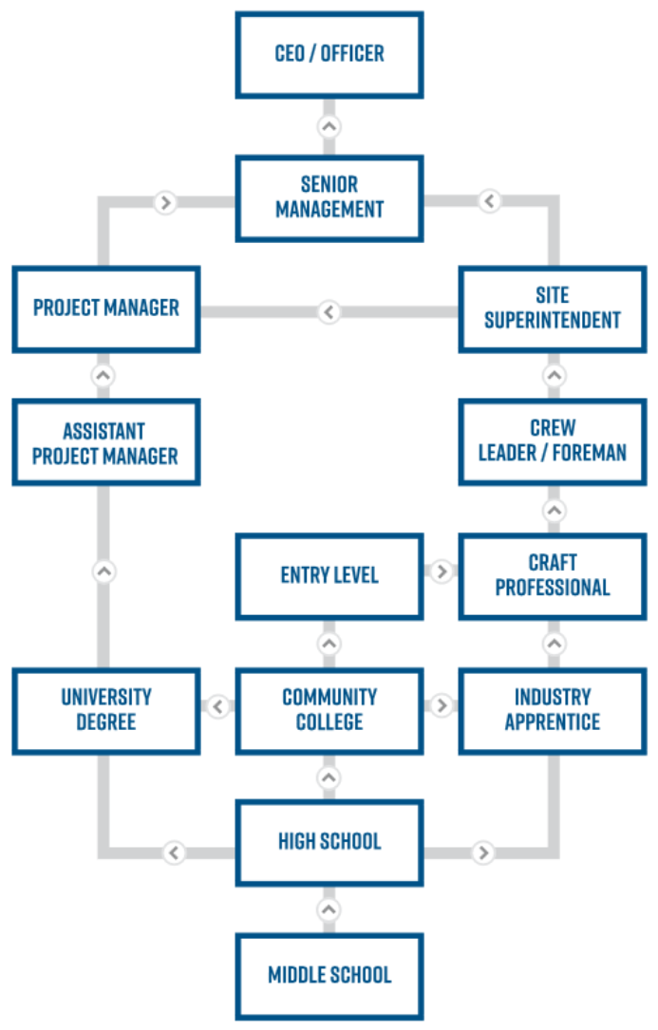
CAREER PATHWAY
THERE ARE MANY PATHS TO A CONSTRUCTION CAREER
There's always a way to gain training, secure the right credentials and begin a career in construction!
Notes:
Again emphasizing that there are many routes someone can take for a construction career.
If you want to immediately hop into the field and start earning money, an apprenticeship might be a good choice. But if you want a more traditional college experience, there are plenty of options through the community college or university path.

Slide 12
Notes:
Click the video to play it. If the play button does not automatically appear during the presentation, right-click the thumbnail and hit “preview,” and then click the play button on the video.
NOTE: Before playing video, make sure the sound is on and the computer or presentation is hooked up correctly. Be sure you are connected to the internet, as the video must connect to YouTube.
Feel free to stop playing at the 1 minute mark, as the closing slide includes a voiceover that isn’t necessarily relevant to the presentation.

Slide 13
WHY CONSTRUCTION?
Great Pay
Unlimited Potential
Salaries are extremely competitive.
Construction offers career advancement and mobility.
High Demand
Leave a Legacy
Their services are needed to make activities in our daily lives possible.
Construction is an industry that has a lasting impression on communities
Satisfaction
Zero Student Loan Debt
Craft pros take pride in being part of something greater than themselves.
Majority of construction careers do not require a degree.
Notes:
Now that your audience knows a bit more about construction and the crafts, it’s time to convince them why they should consider a career in construction.
What makes this a great career?
Skilled professionals are well-paid, and salaries continue to climb. If you personally made a nice living in construction, give some examples of how you are enjoying financial security!
Lots of students go to college, earn a degree, and then find there are no jobs in that field. Well, construction doesn’t have that problem. There is a growing demand for craft professionals, with an estimated shortage of 1.4 million construction workers by 2022. Craft skills are skills for real jobs that companies are actually hiring for. (Statistic from ManPower – Skilled craft positions continue to be in the top five hardest jobs to fill globally.)
Construction workers have a high degree of job satisfaction. A 2015 report found that, out of all industries, construction had the happiest employees.
Skilled craft professionals have unlimited potential. It is not a dead-end job. There are many opportunities to advance and grow your career. You can go from an apprentice to a manager or supervisor to a company executive or owner.
Finally, you have the ability to leave a legacy. You can drive by a building on the street and say “I helped build that.” The hospitals you build will help save lives. The schools you build will teach future generations.
Share why you personally enjoy your career in construction. Is it the friends you make and people you meet? Is it the ability to express your creativity or make an impact in the community? Is it the ability to give your family a comfortable life?

Slide 14
$98,965
$58,046
$70,880
$57,646
Average Salary
$43,000
Average base salaries for journeyman-level craft professions often push past $60,000 a year or more.
With travel bonuses and other incentives, you can make six figures!
Craft
Laborer
Concrete Finisher
Mason
Project Manager
Surveyor
Notes:
More information about salaries in support of the previous slide.
Many people think that construction workers are just laborers who have limited skills and limited options that don’t get paid much.
But the truth is construction workers are skilled craft professionals who enjoy their jobs and get paid well for their unique and in-demand talents!

Slide 15
Notes:
Click the video to play it. If the play button does not automatically appear during the presentation, right-click the thumbnail and hit “preview,” and then click the play button on the video.
NOTE: Before playing video, make sure the sound is on and the computer or presentation is hooked up correctly. Be sure you are connected to the internet, as the video must connect to YouTube.
Feel free to stop playing at the 1 minute mark, as the closing slide includes a voiceover that isn’t necessarily relevant to the presentation.

Slide 16
Explore Career Pathways, Salaries and More
Automatically Format Your Resume
Connect With Employers Near You
Discover Educational Opportunities In Your Area
Get Hired!
Made Possible By:
Notes:
A great way for students to get started on their construction exploration journey is with CareerStarter. On CareerStarter students can take a career quiz and explore their matches to see what the world of construction has to offer them.

Slide 17
INTERESTED?
Scan Or Visit The Link Below To Register
Notes:
You can even have them sign up and take the career quiz as a classroom activity at this point in your presentation.
Be sure your company is on the platform to further incentive students to connect with you and be updated whenever new job opportunities in your organization become available. They can favorite your organization to connect at a later date as well.

Slide 18
Your Name
Your Title
123-456-7890
mail@company.com
@your profile
Team Member’s Name
Their Title
123-456-7890
mail@company.com
@your profile
Team Member’s Name
Their Title
123-456-7890
mail@company.com
@your profile
Notes:
Fill in your company contact information. If you have an apprenticeship program, include ways to get involved.
Thank the audience for their attention and ask if there are any questions.
Fill in your company contact information. If you have an apprenticeship program, include ways to get involved.
Thank the audience for their attention and ask if there are any questions.

